Slide 1
Via Dinarica White Trail
It’s Not For Everyone
July 3‒August 24, 2017

Slide 2
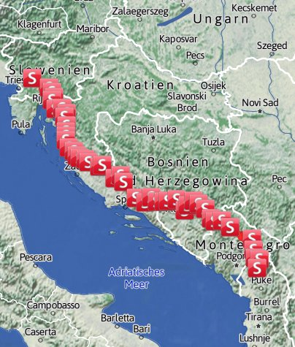

Slide 3
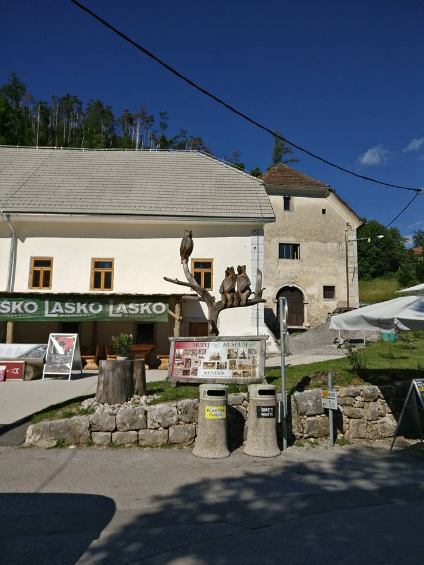

Slide 4
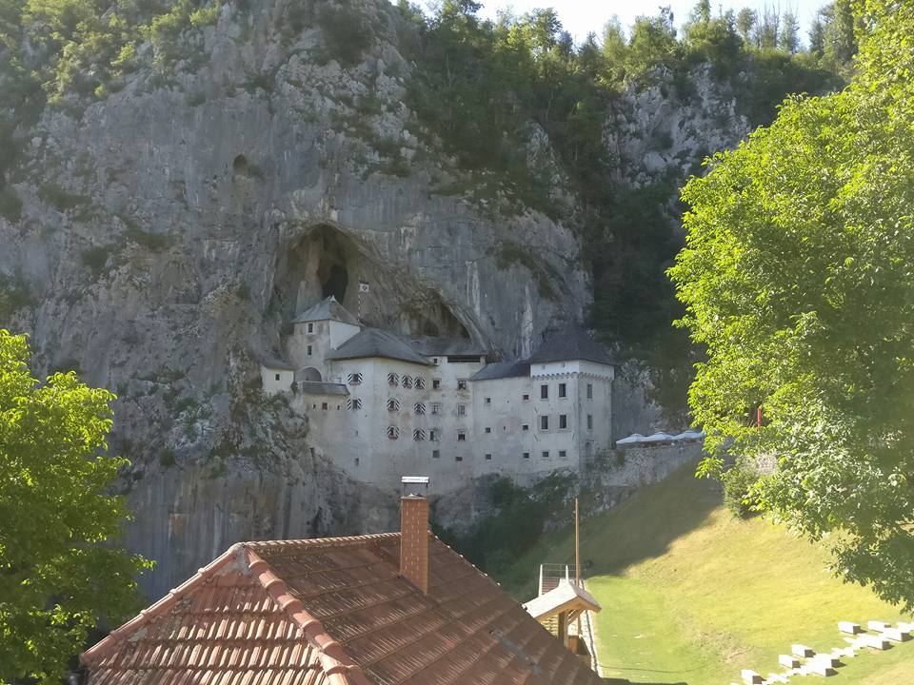

Slide 5
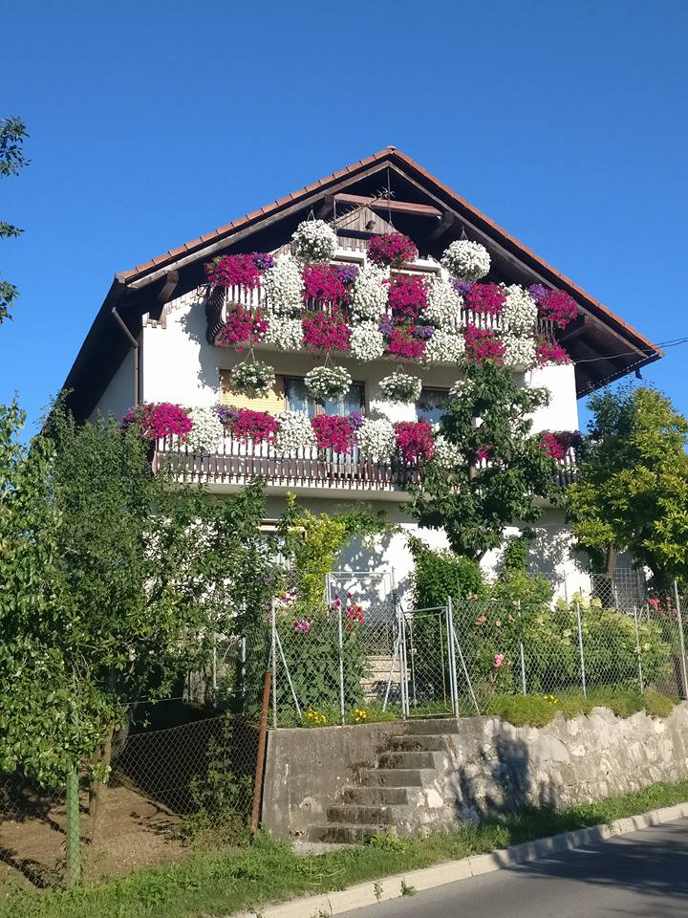

Slide 6
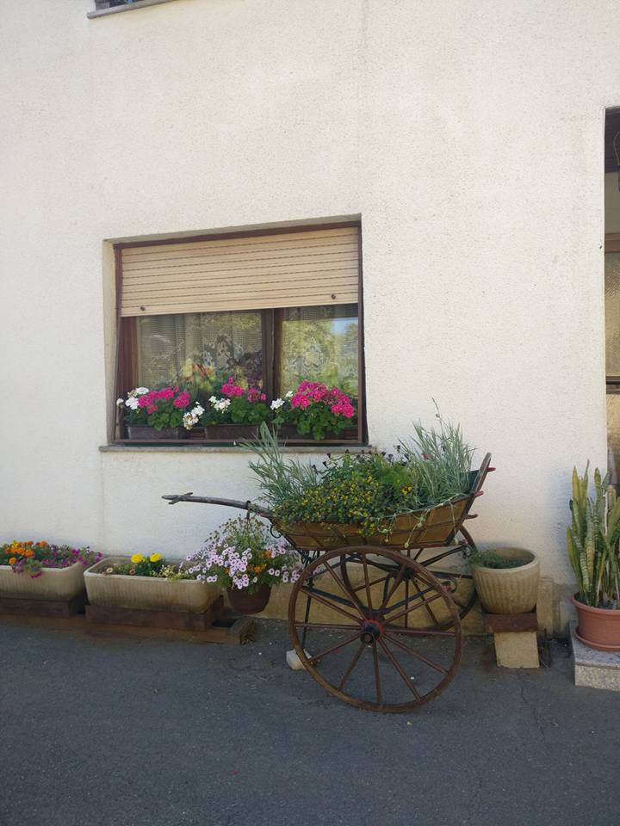

Slide 7
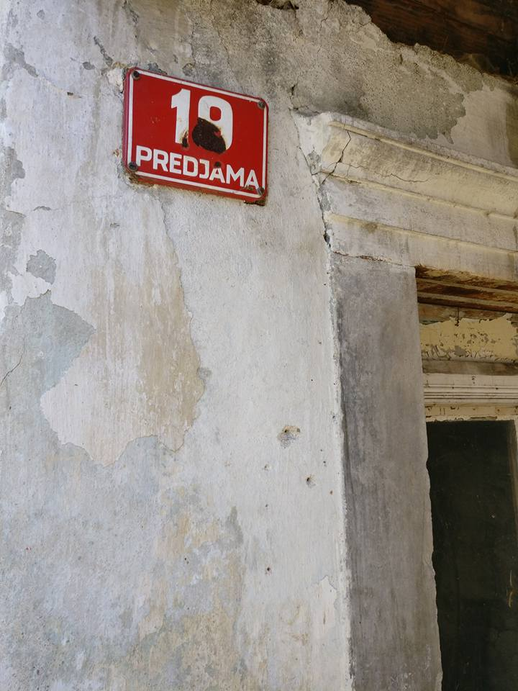

Slide 8
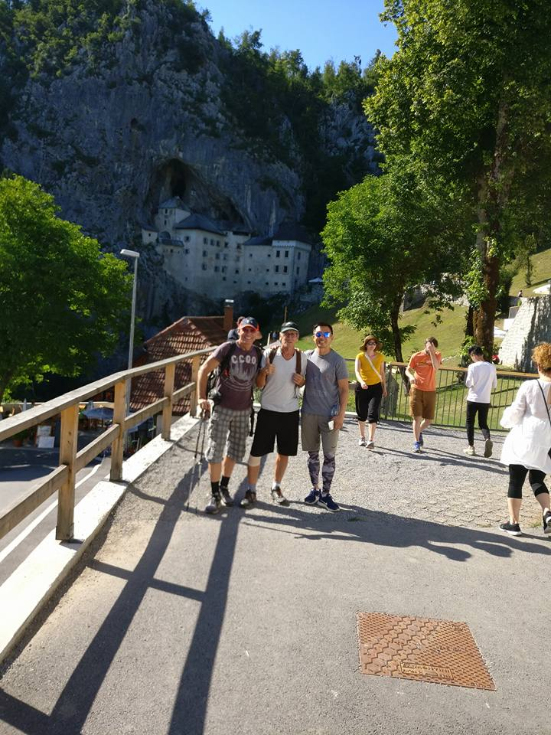

Slide 9
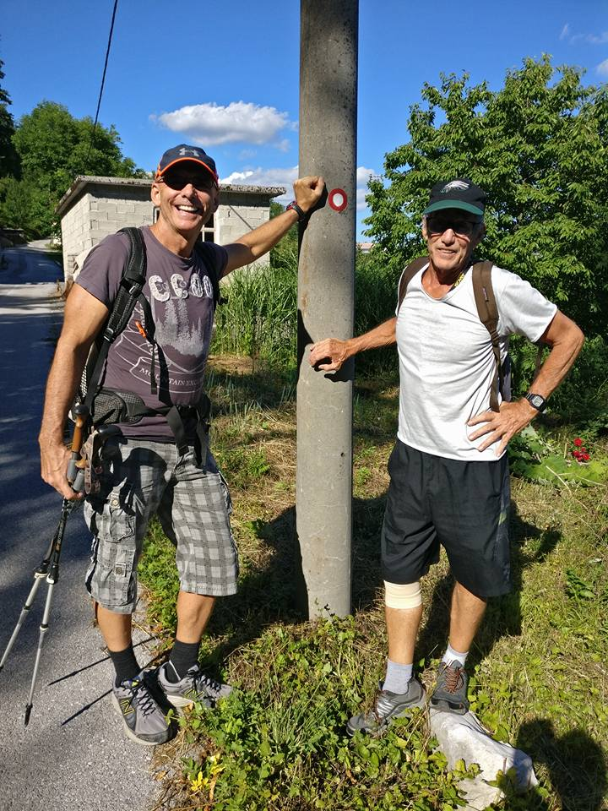

Slide 10
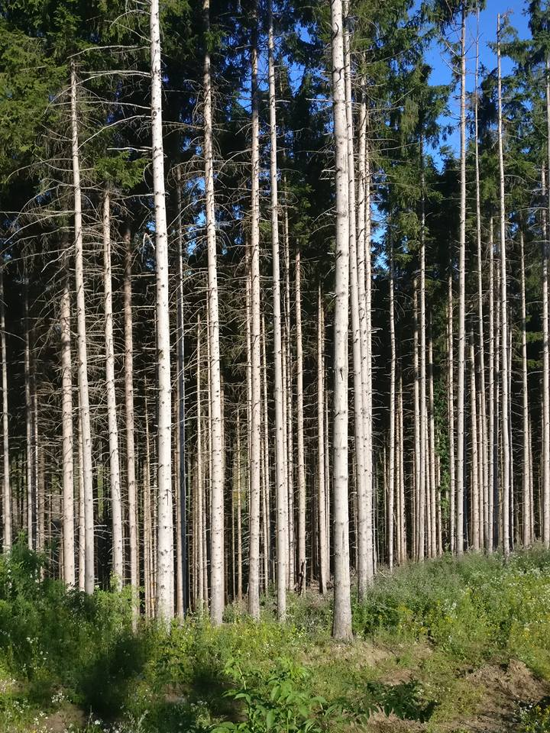

Slide 11
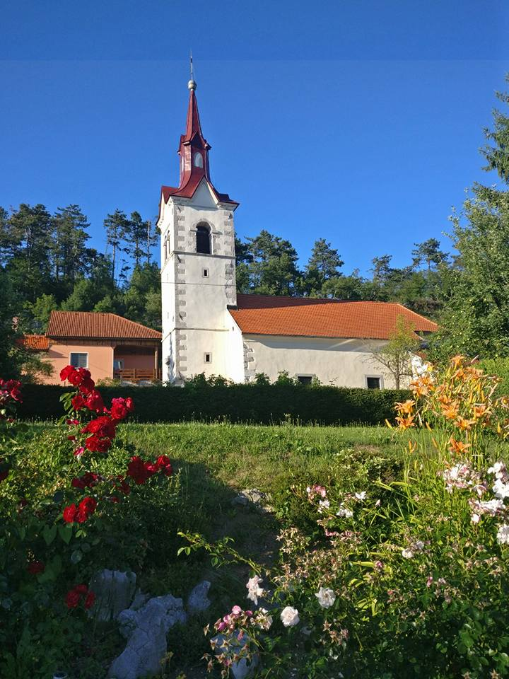

Slide 12
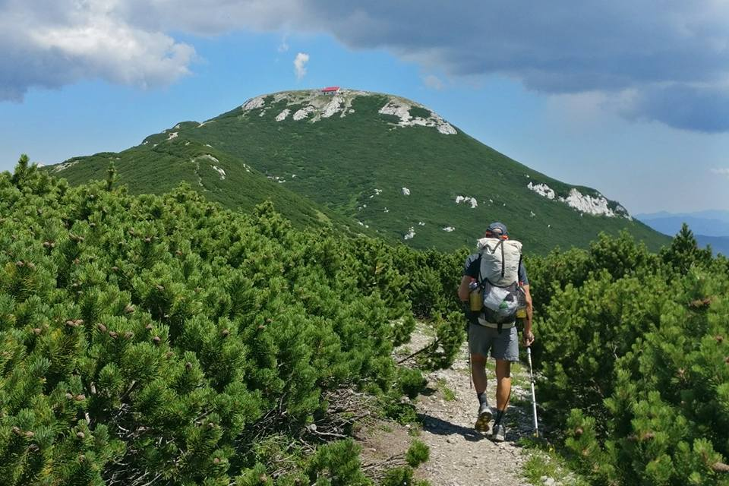

Slide 13
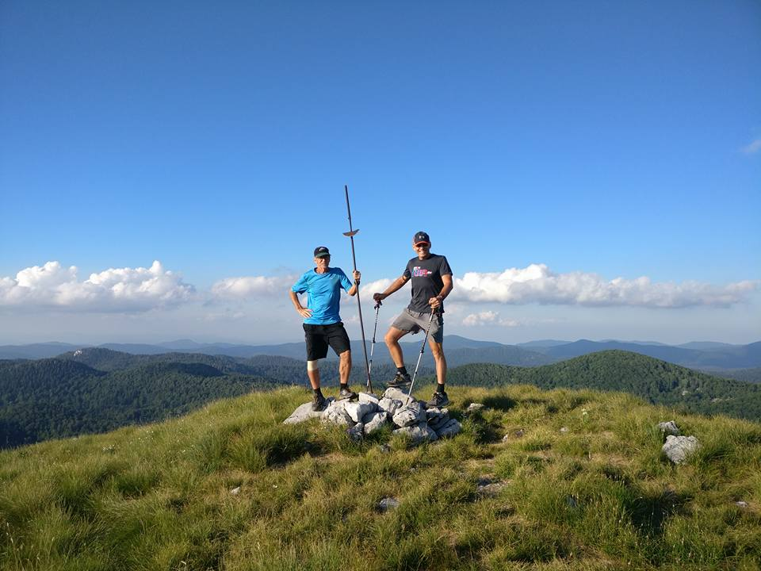

Slide 14
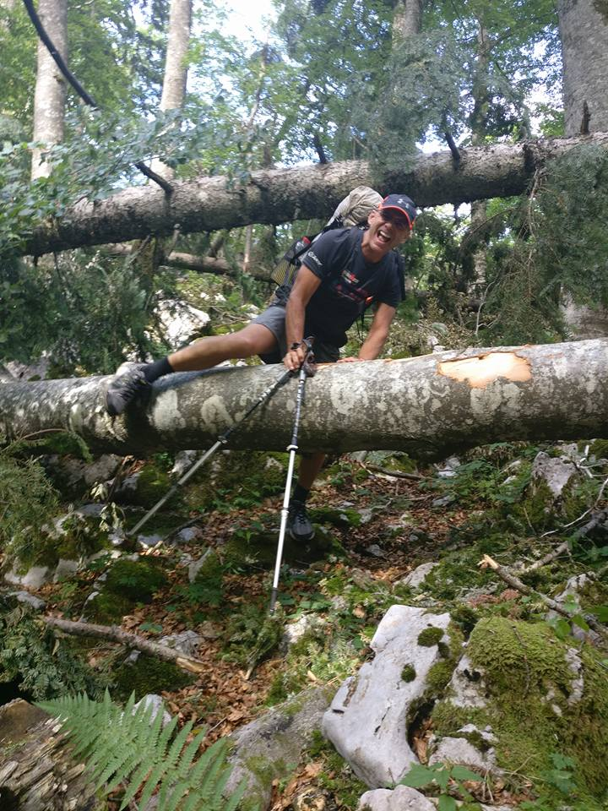

Slide 15
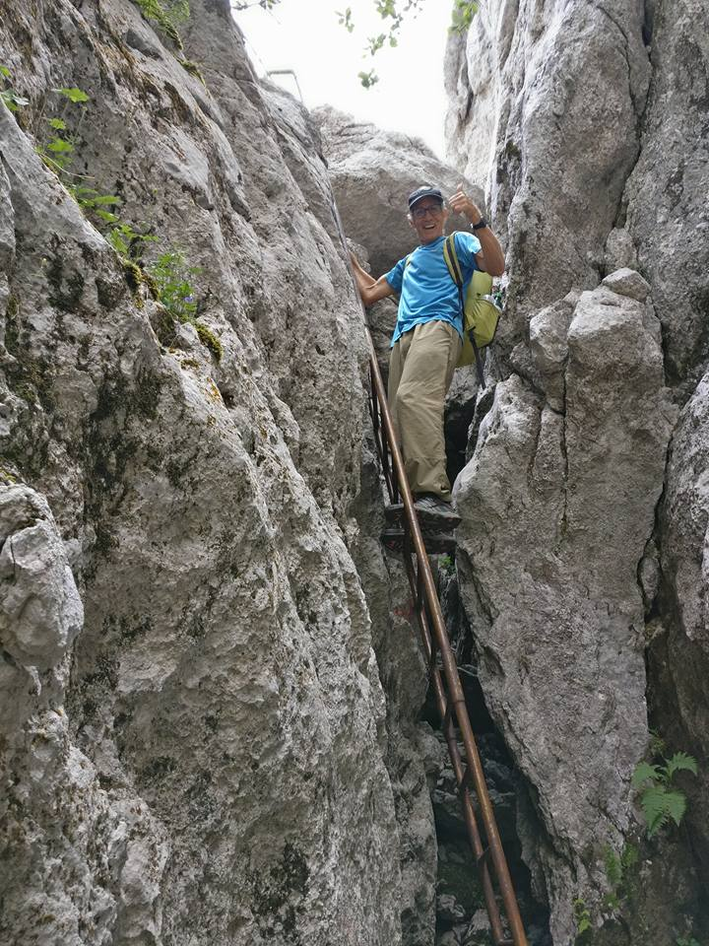

Slide 16
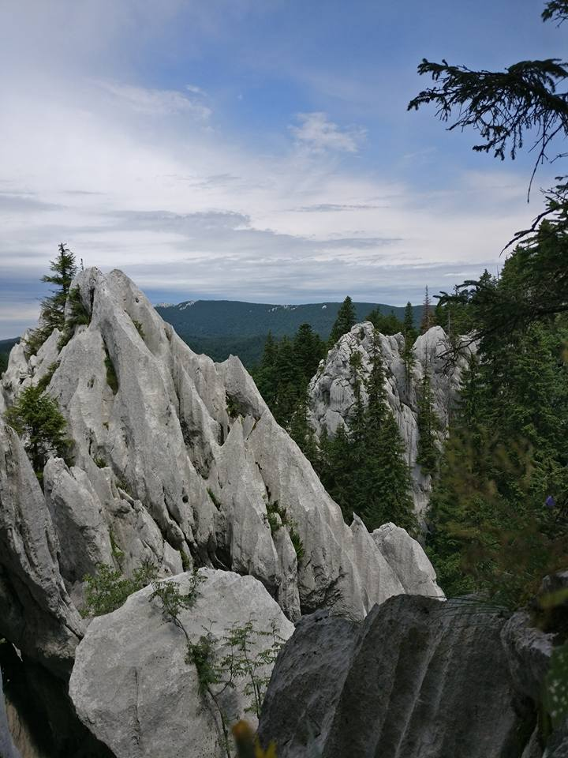

Slide 17
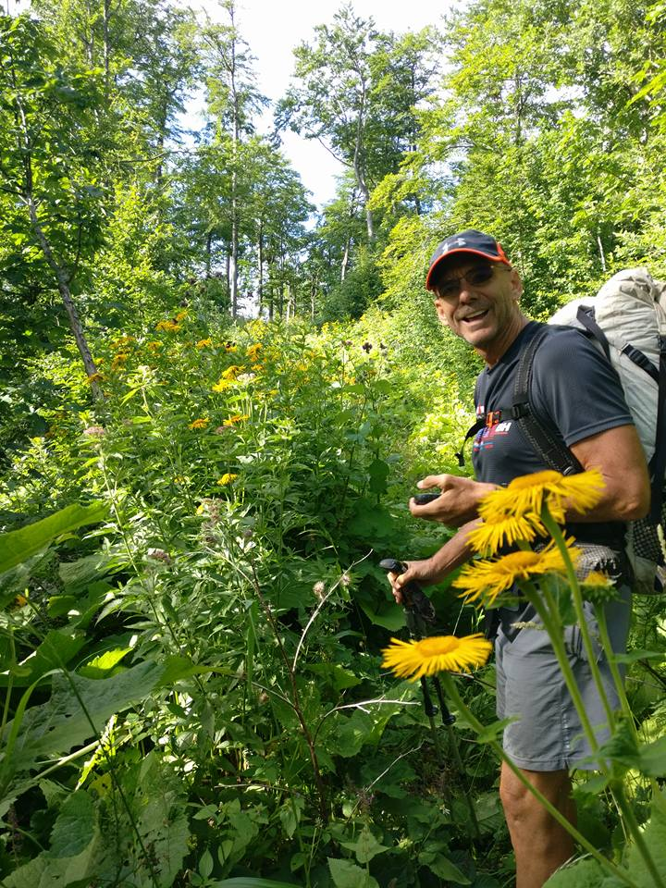

Slide 18
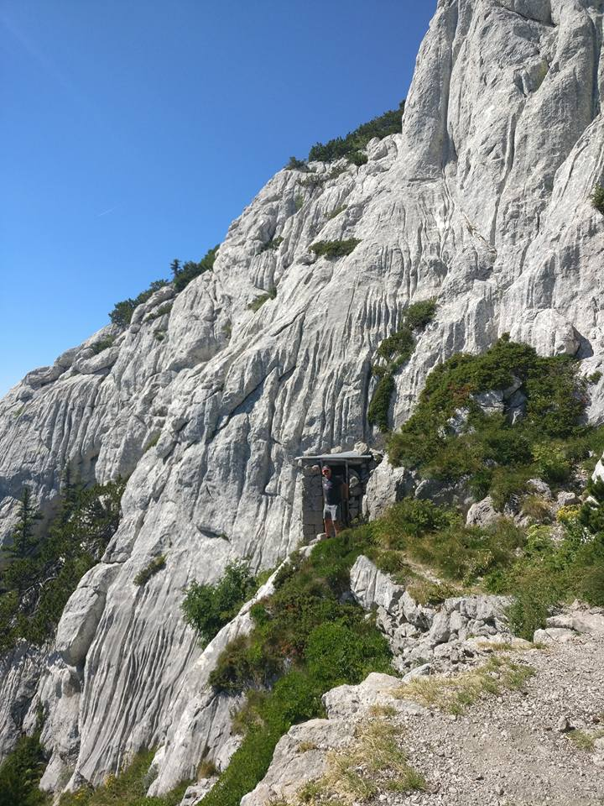

Slide 19
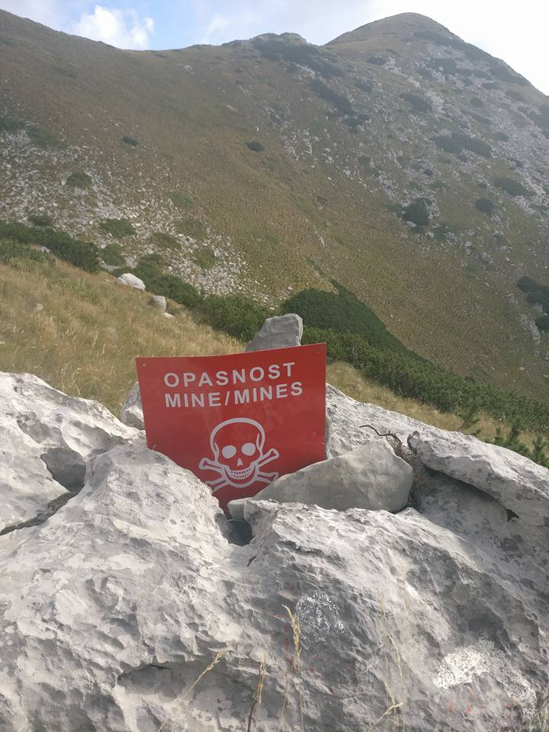

Slide 20
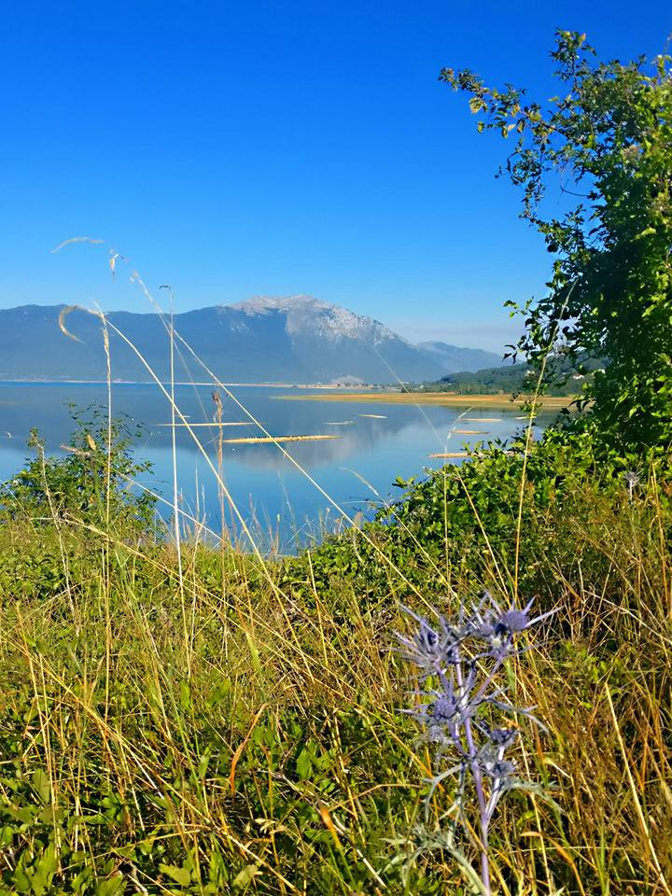

Slide 21
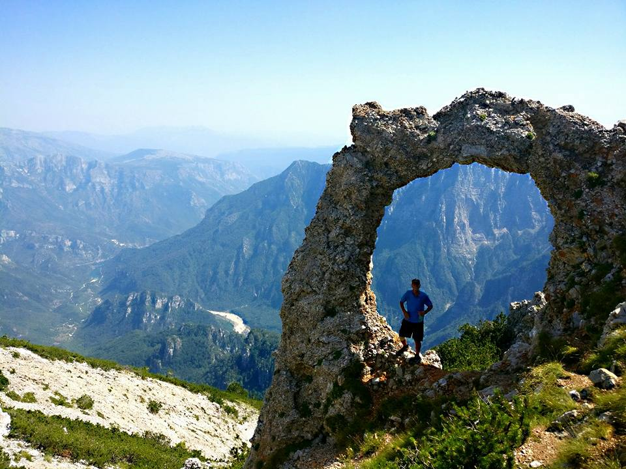

Slide 22
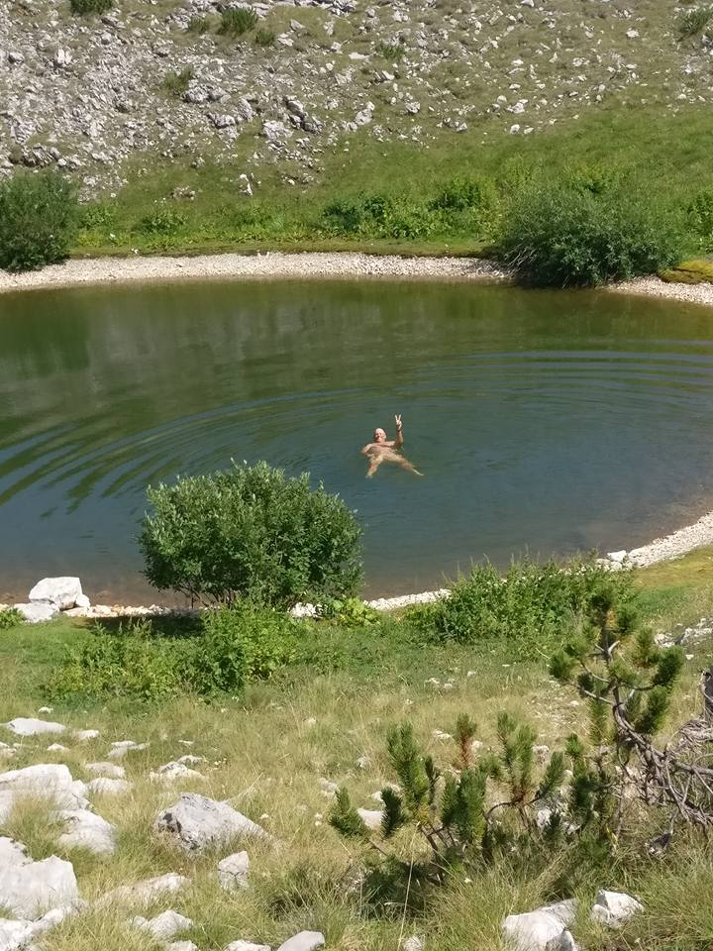

Slide 23
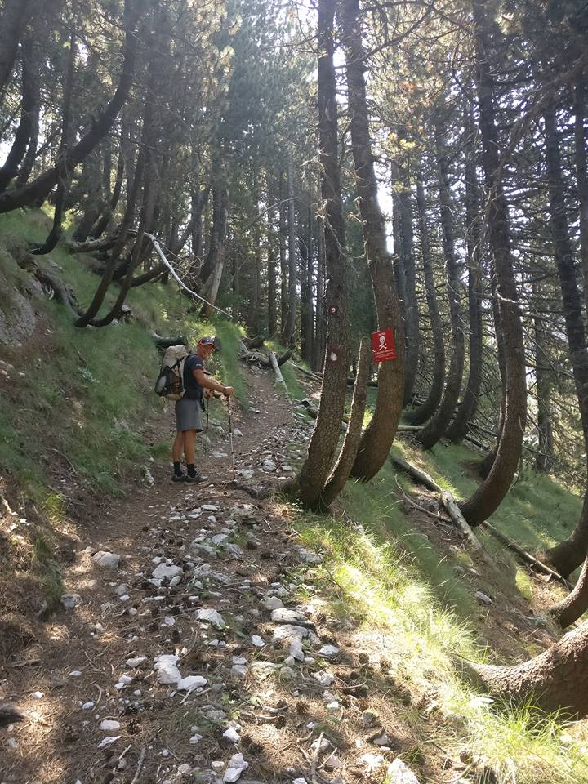

Slide 24
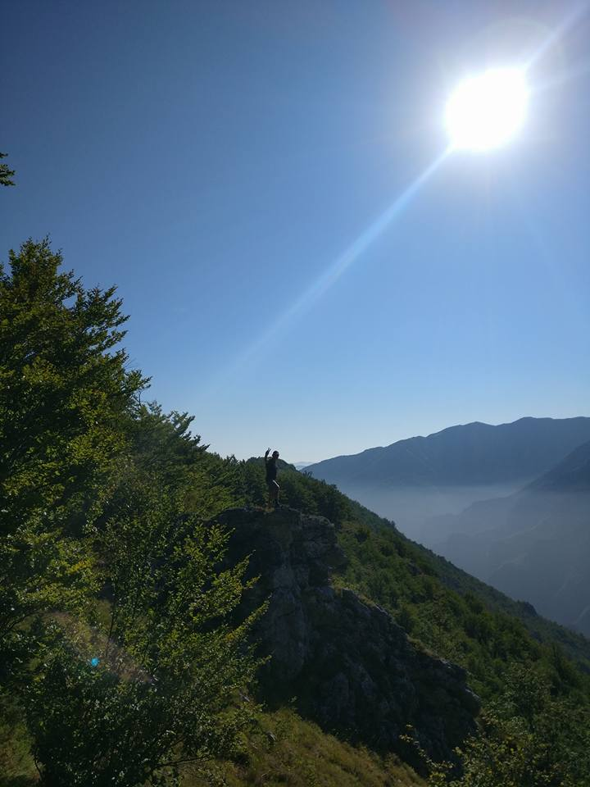

Slide 25
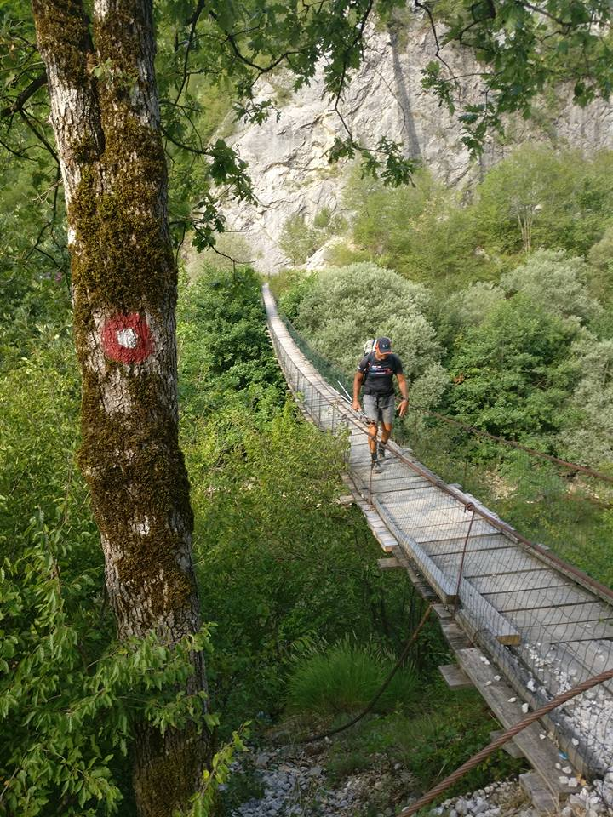

Slide 26
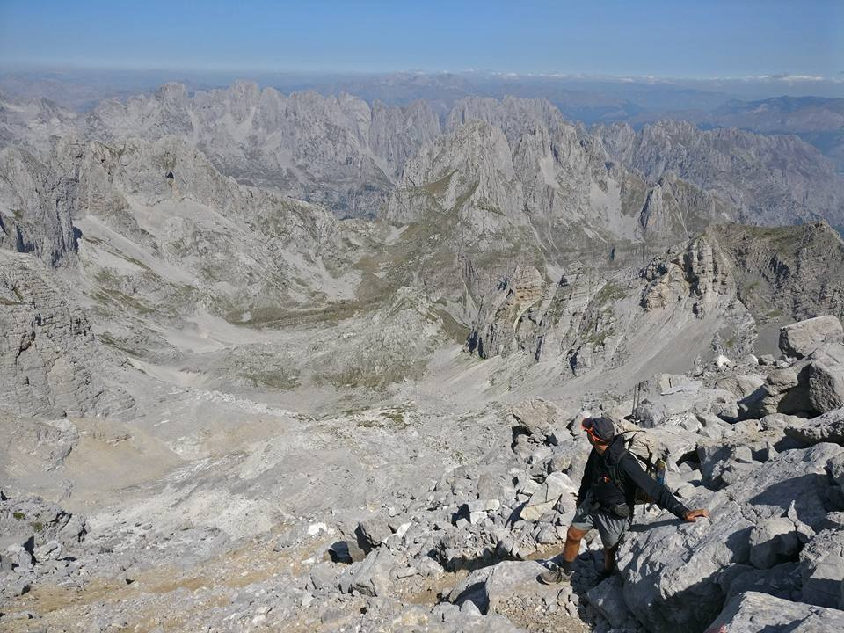

Slide 27
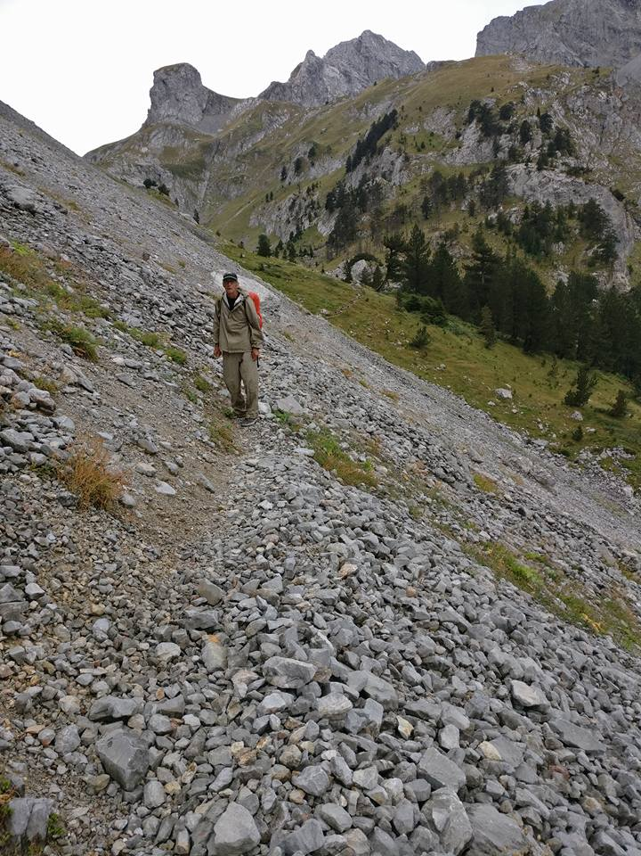

Slide 28
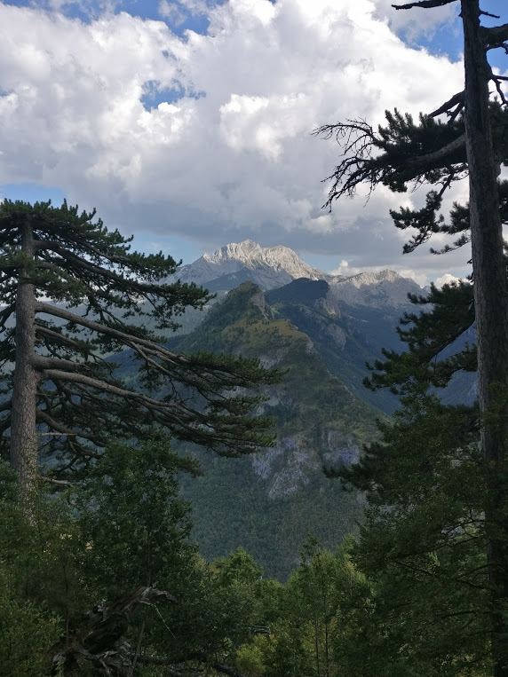

Slide 29
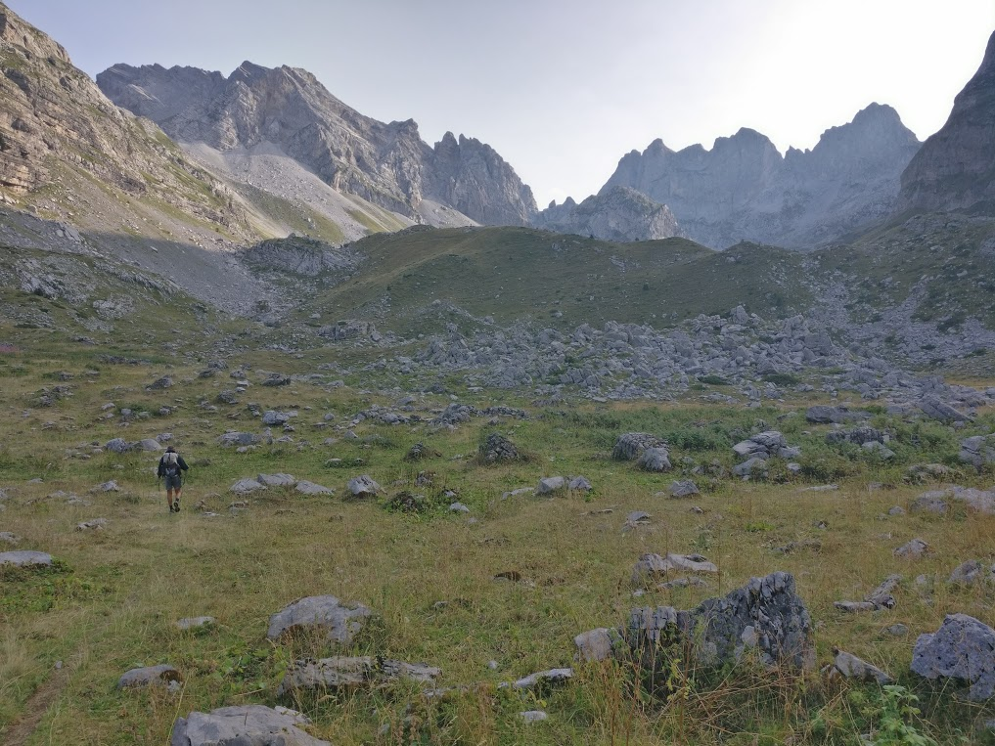

Slide 30
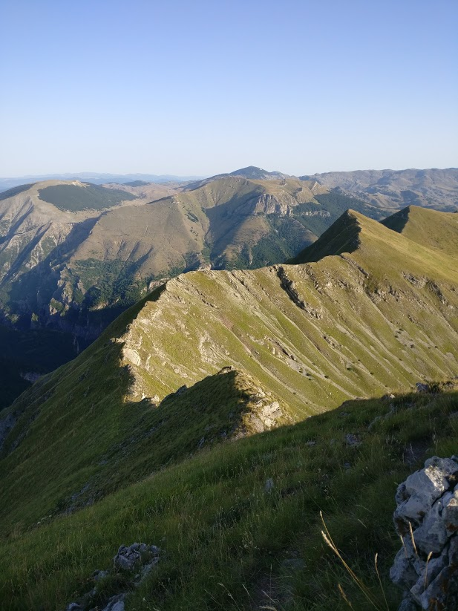

Slide 31
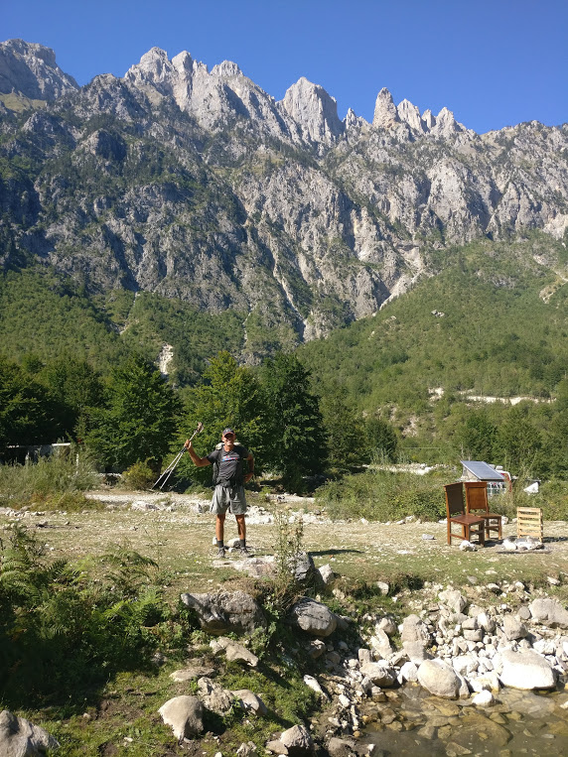

Slide 32
Outline
Introduction
Databook
The Countries
Gear
The Trail
The People
Final Thoughts

Slide 33
Outline
Introduction
Databook
The Countries
Gear
The Trail
The People
Final Thoughts

Slide 34
Introduction
Via Dinarica White Trail
Follows highest peaks of Dinaric Alps in Balkan Peninsula
Outside Magazine’s Best New Trail 2016
Featured in National Geographic Travel
1,258 kilometers spanning five Balkan countries: Slovenia, Croatia, Bosnia Herzegovina, Montenegro, and Albania
52,000 meters of climbing
Expanded in late 2017 to include sections in Kosovo, Serbia, and Macedonia
Few thru-hikers and with good reason
Bosnia is the only country with an official trail

Slide 35
Country Size
Slovenia: 83 kms, slightly smaller than New Jersey (47), capital: Ljubljana
Croatia: 558 kms, slightly smaller than West Virginia (41), capital: Zagreb
Bosnia Herzegovina: 326 kms, similar to Croatia, capital: Sarajevo
Montenegro: 254 kms, slightly smaller than Connecticut (48), capital: Podgorica
Albania: 37 kms, slightly smaller than Maryland (42), capital: Tirana

Slide 36
Outline
Introduction
Databook
The Countries
Gear
The Trail
The People
Final Thoughts

Slide 37
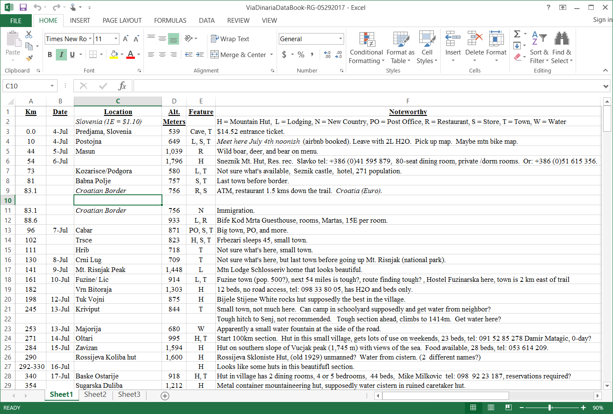
Databook

Slide 38
Navigation
GPS, Garmin eTrex 30
Track but sometimes no trail
Outdoor Active App and hikers’ comments
Eva’s Project (http://www.evadinaricaproject.com/en/)
Claire’s comments (http://reiske.nl/en/)
Via Dinarica Project (https://viadinarica.com/en/)

Slide 39
Outline
Introduction
Databook
The Countries
Gear
The Trail
The People
Final Thoughts

Slide 40
Slovenia
Population: 1,970,000
Religion: 57.8% Roman Catholic, 23% unspecified, 10.1% none
Per capita income: $32,100
Unemployment rate: 11.2%
EU member
Beautiful forest
Lack of water
Incredibly friendly and helpful people
Closely associated with Western Europe
Good food

Slide 41
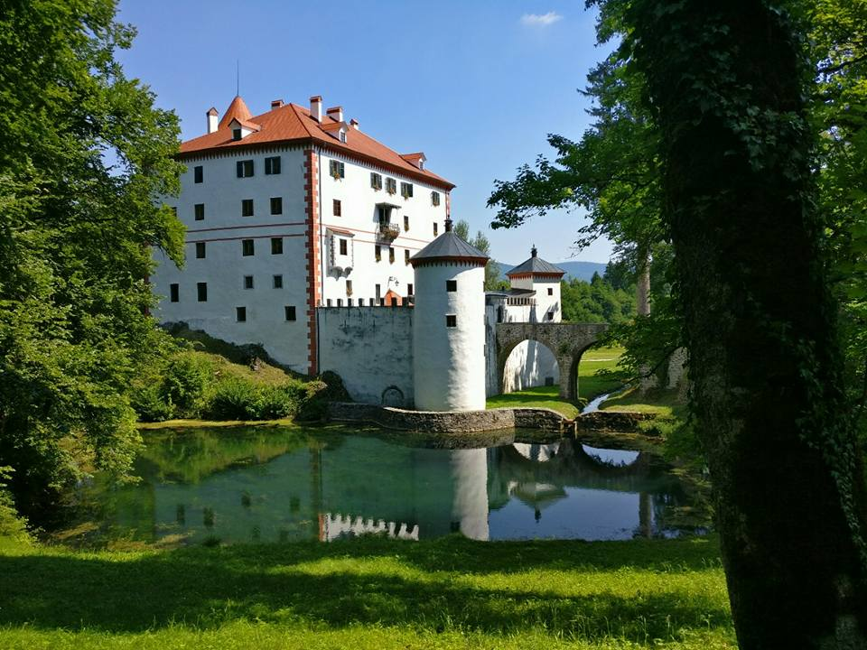

Slide 42
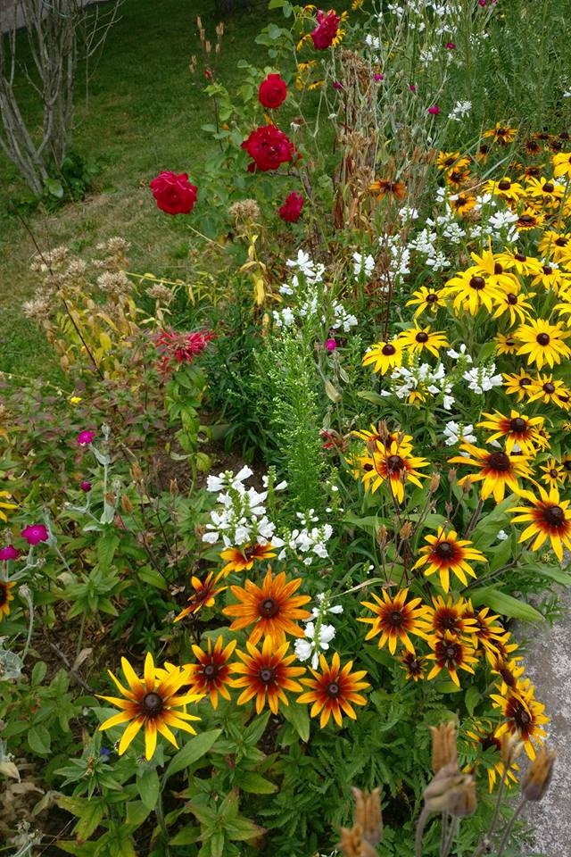

Slide 43
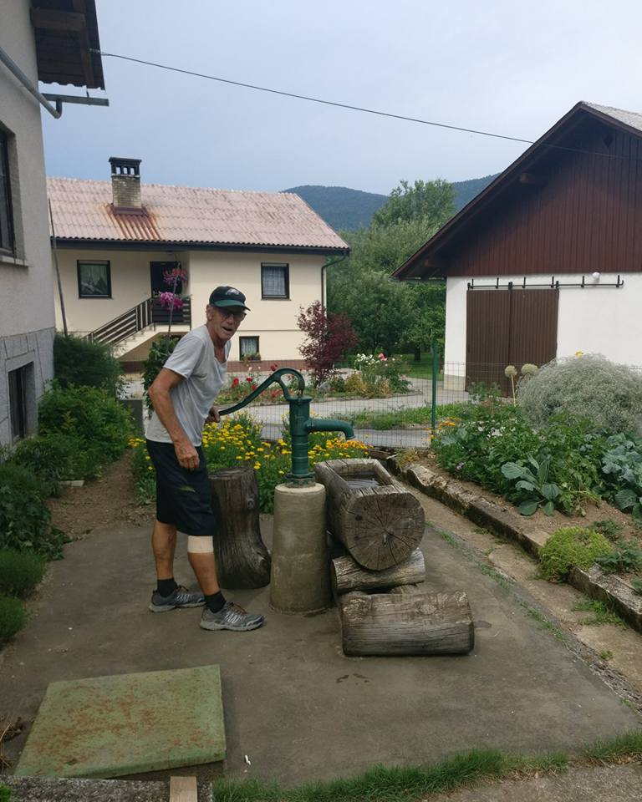

Slide 44
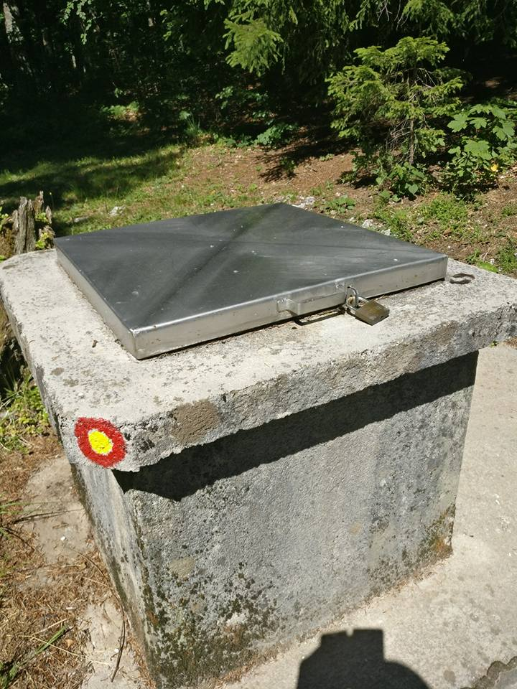

Slide 45
Croatia
Population: 4,292,000
Religion: 86.3% Roman Catholic
Per capita income: $22,800
Unemployment rate: 15.8%
EU member
Rocky mountains
One section of the trail closed due to land mines
Lack of water
Incredibly friendly and helpful people
Still recovering from war in the 90s
Lots of meat

Slide 46
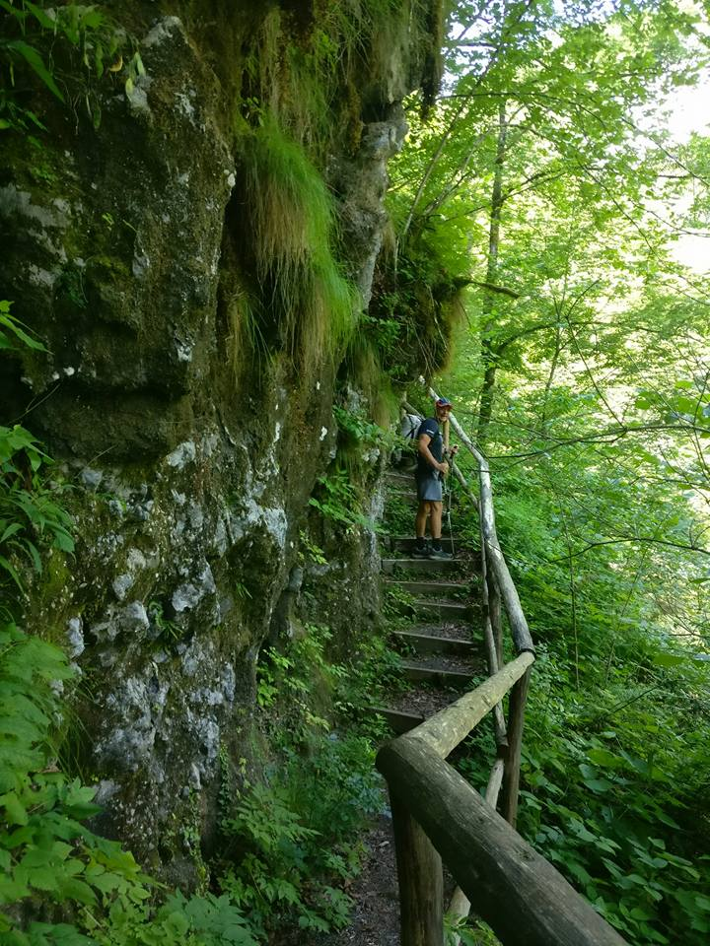

Slide 47
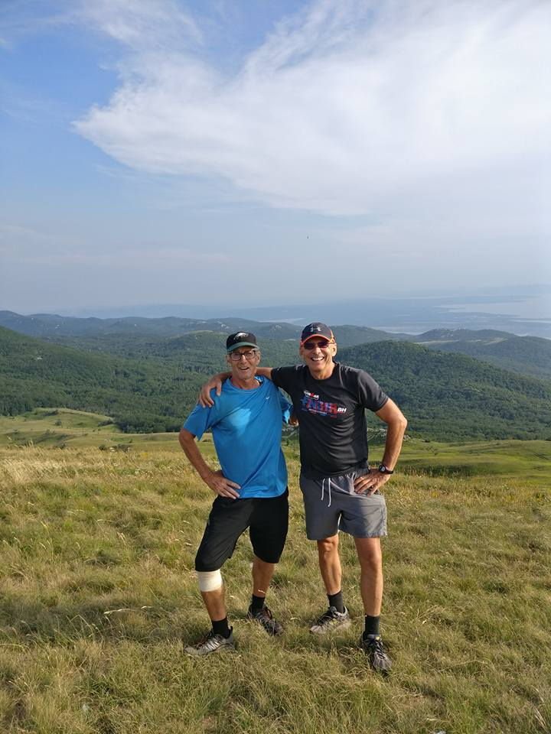

Slide 48
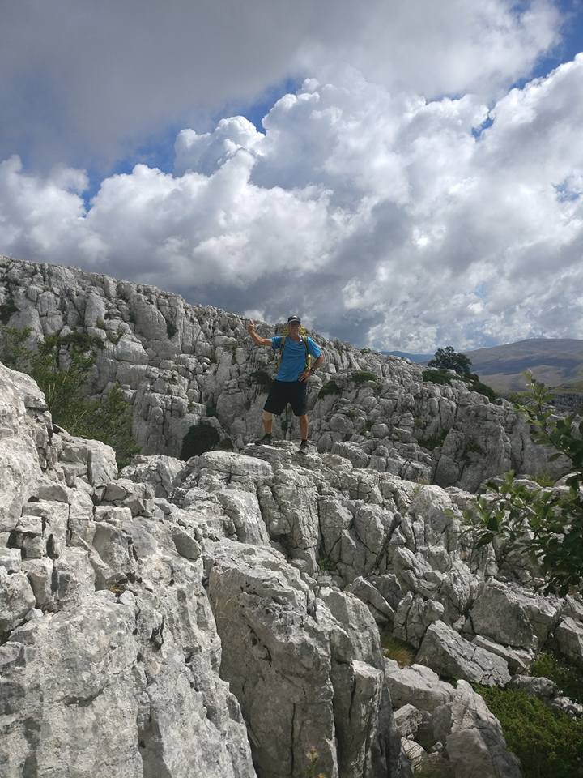

Slide 49
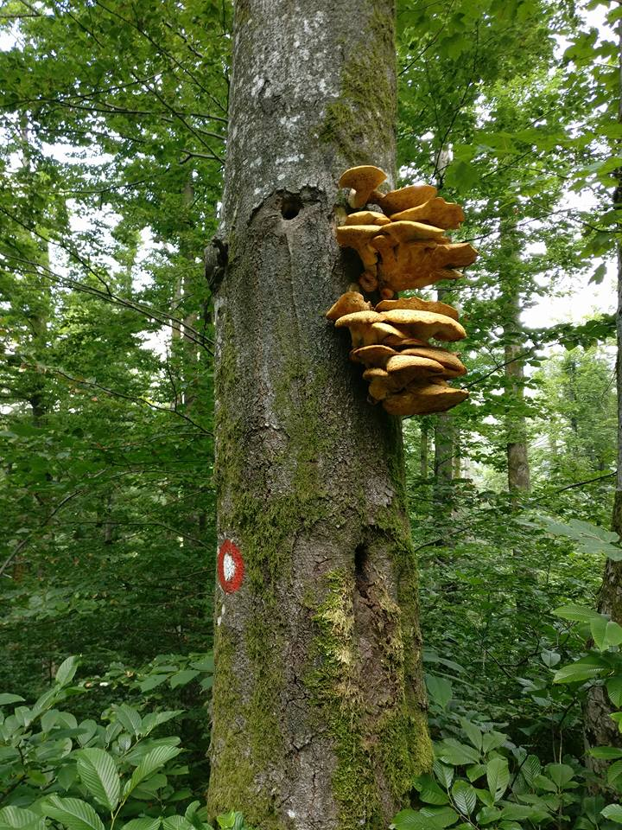

Slide 50
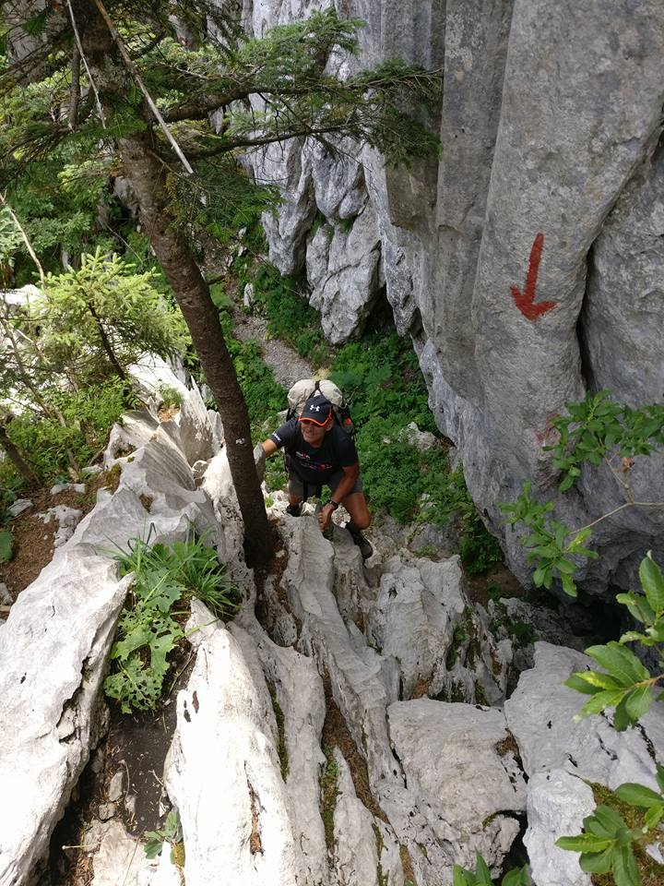

Slide 51
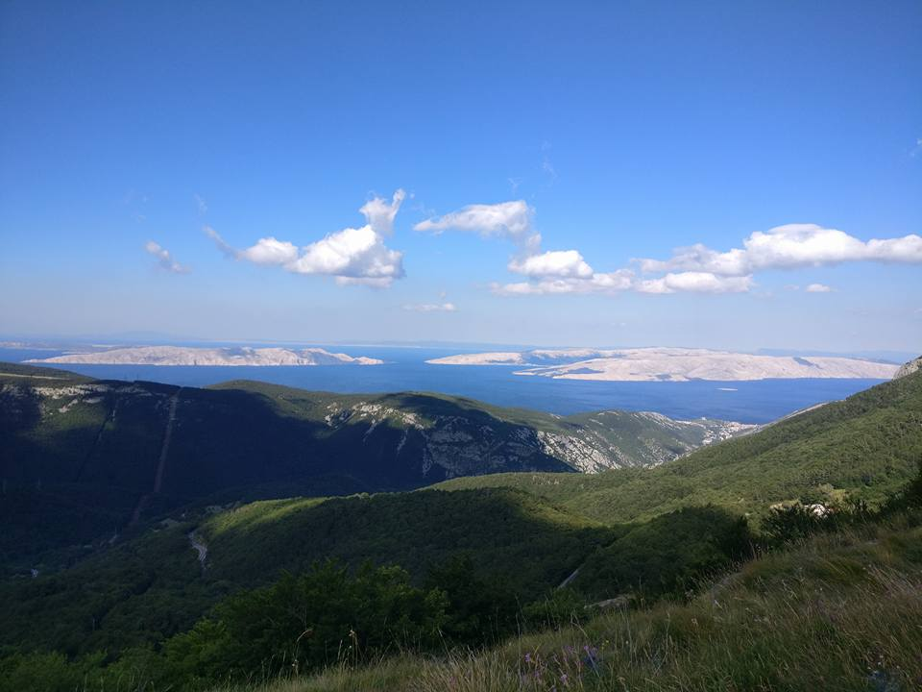

Slide 52
Bosnia Herzegovina
Population: 3,856,000
Religion: 50.7% Muslim, 30.7% Orthodox, 15.2% Roman Catholic
Per capita income: $11,000
Unemployment rate: 28%
Recognized as a potential candidate for EU membership
Rocky mountains
Incredibly friendly and helpful people
Still recovering from war in the 90s
Great food, wonderful tomatoes
Our favorite country on the trail

Slide 54
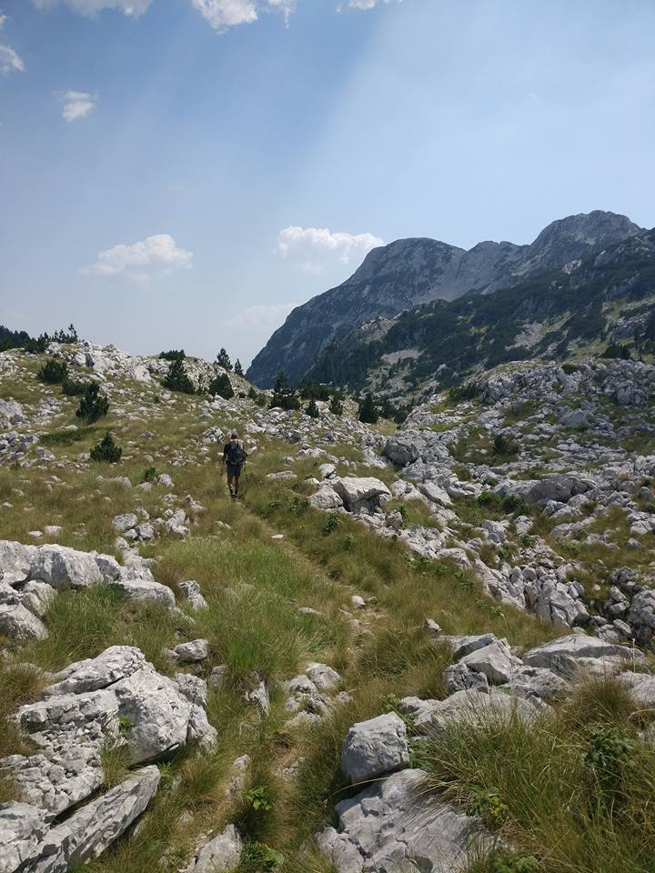

Slide 55
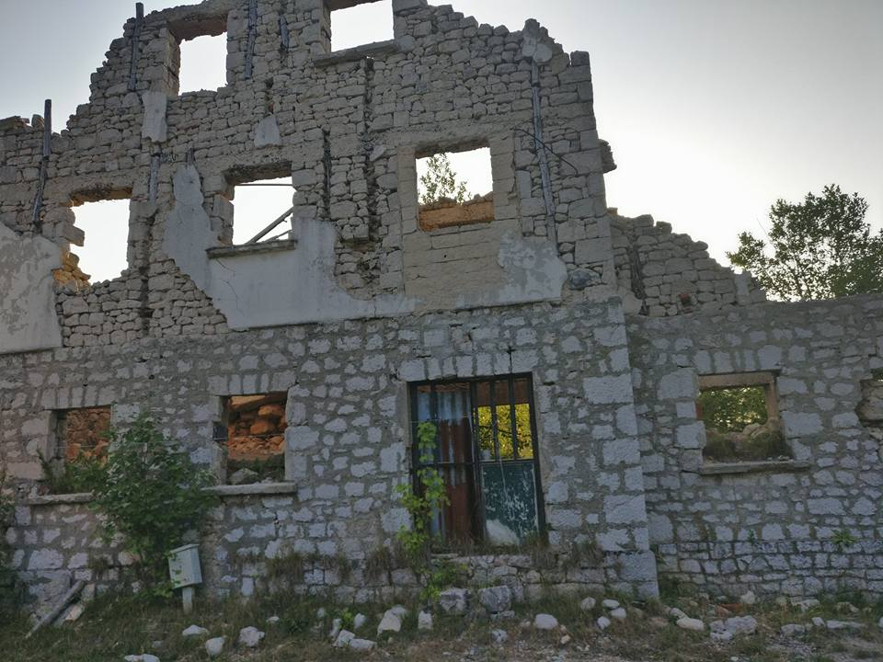

Slide 56
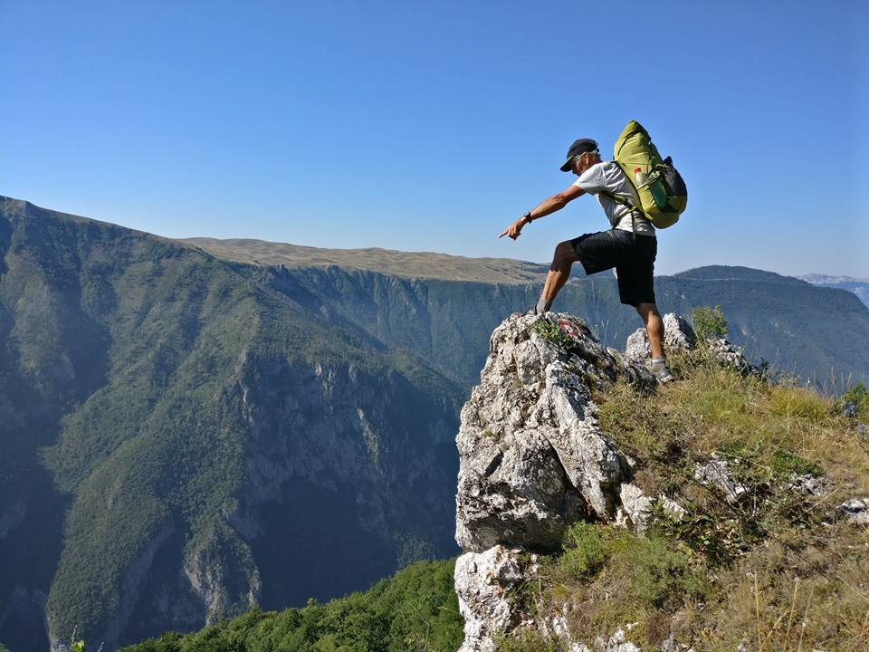

Slide 57
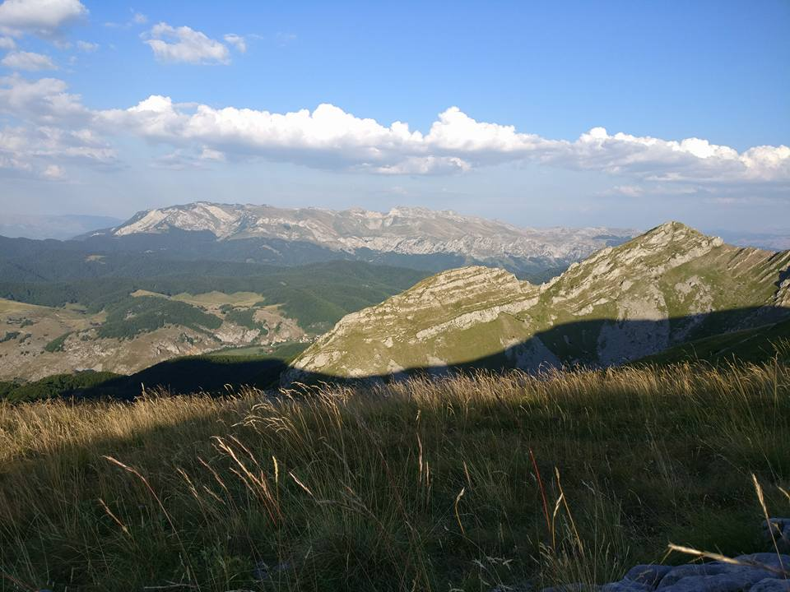

Slide 58
Montenegro
Population: 643,000
Religion: 72.1% Orthodox, 19.1% Muslim
Per capita income: $16,600
Unemployment rate: 17.1%
Could join EU by 2022
Montenegro became independent from Serbia in 2006
Not as rocky as expected
Beautiful rolling hills
Lots of walking on dirt roads
Decent food

Slide 59
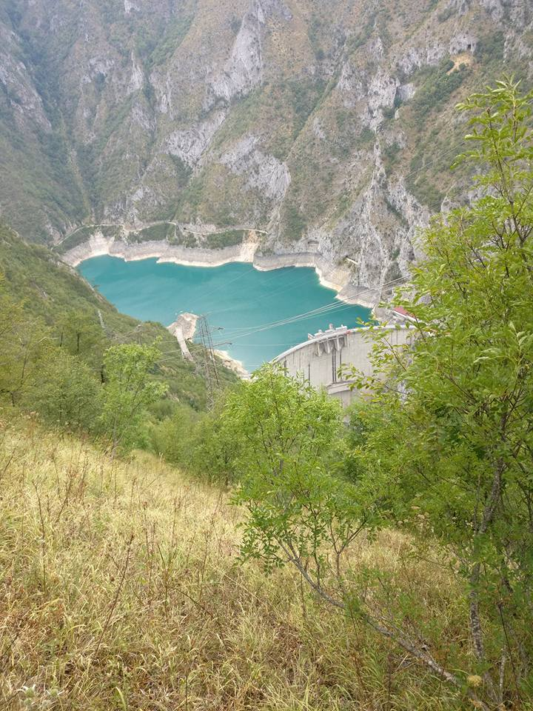

Slide 60
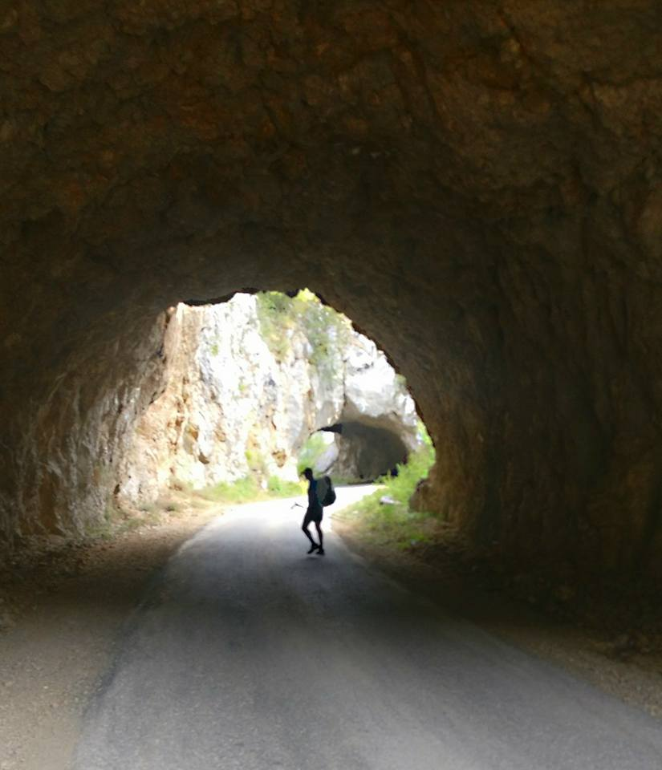

Slide 61
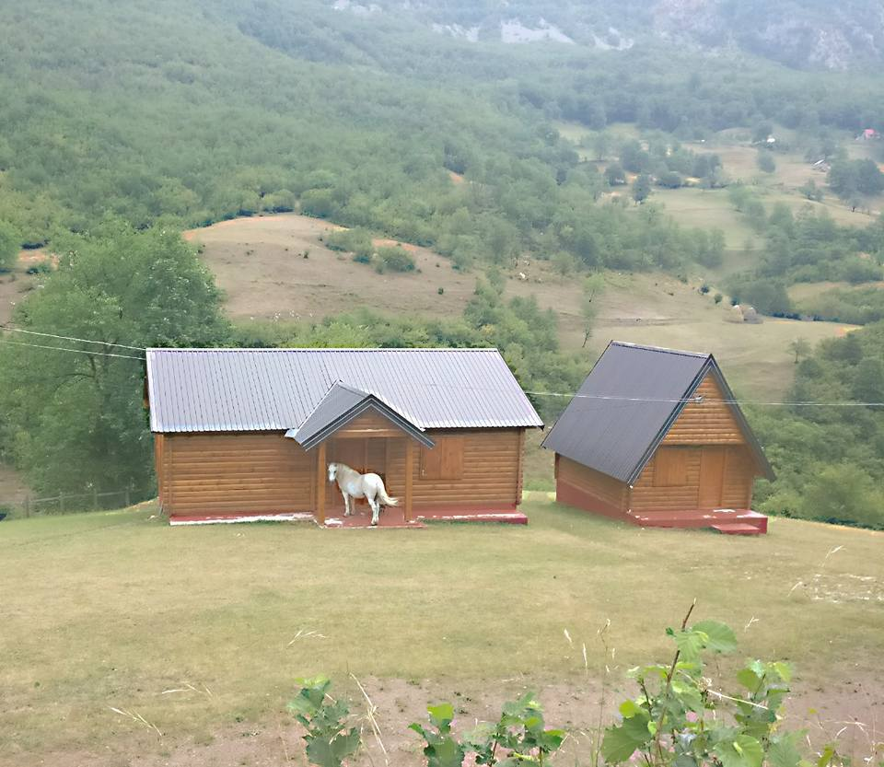

Slide 62
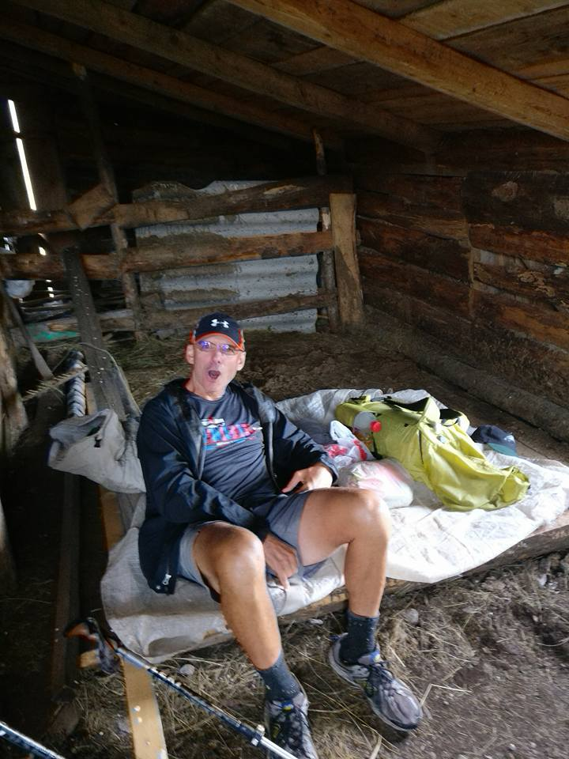

Slide 63
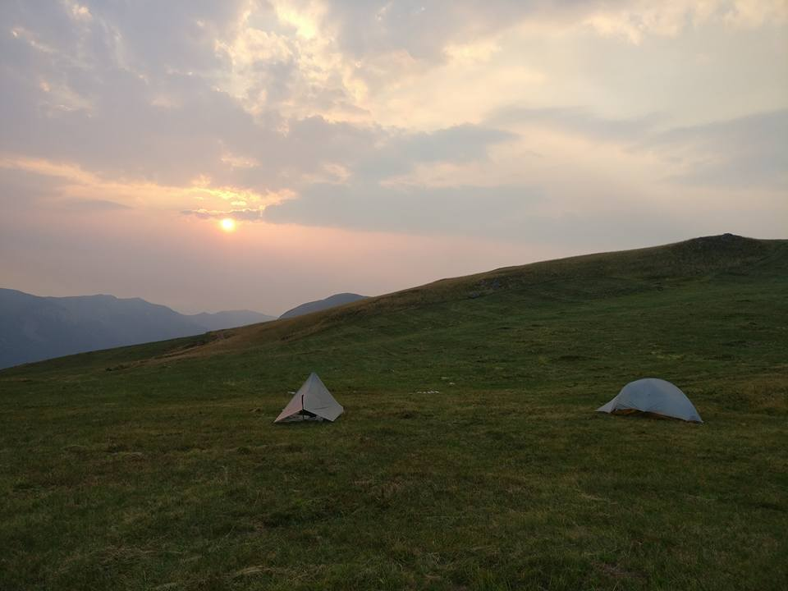

Slide 64


Slide 65


Slide 66


Slide 67
Albania
Population: 3,048,000
Religion: 56.7% Muslim, 16.2% unspecified, 10% Roman Catholic, 6.8% Orthodox
Per capita income: $11,800
Unemployment rate: 14.5%
In 2014 moved to Candidate Status for EU membership, ongoing negotiations
Incredibly wild and rugged mountains
Rock climbing section near Albania’s highest peak should be removed from the Via Dinarica
Great food

Slide 68


Slide 69


Slide 70


Slide 71


Slide 72


Slide 73
Outline
Introduction
Databook
The Countries
Gear
The Trail
The People
Final Thoughts

Slide 74
Gear
Total pack weight (no food and no water): 237.6 ounces = 14 pounds 14.6 ounces
Total weight on person, including clothes: 71.1 ounces = 4 pounds 7.1 ounces
Pack, shelter, and sleeping gear: 105.1 ounces = 6 pounds 9.1 ounces
Hyperlight Mountain Gear (HMG) Windrider 3400 pack: 32.1 ounces
REI Igneo Long 19F down sleeping bag in medium HMG stuff-sack w/ plastic bag: 31.0 ounces
Big Agnes one-person tent: 28.0 ounces
Full length thermarest: 14.0 ounces
Clothes Usually in Pack: 74.0 ounces = 4 pounds 11.0 ounces
Marmot rain pants: 20.0 ounces
Lightweight Patagonia down jacket: 18.0 ounces
Marmot Gortex rain coat: 17.0 ounces
Mountain Hardwear warm hat: 6.0 ounces
Pearl Izumi medium weight gloves: 5.4 ounces
Speedo swimsuit: 3.9 ounces
One pair of smart wool socks: 3.1 ounces
HMG large stuff sack w/ plastic bag: 1.6 ounces

Slide 75
Gear continued
Miscellaneous: 58.5 ounces = 3 pounds 12.5 ounces
Smart phone and charger cellphone: 8.7 ounces
Etrek 30 GPS bundle, includes AA batteries: 6.2 ounces
Coleman Deet insect repellent: 5.5 ounces
Aqua Mira water treatment drops (60 gallons): 5.5 ouncs
Sunblock: 4.0 ounces
Petzel Tikka headlamp: 3.5 ounces
Four spare AA batteries: 3.4 ounces
First aid kit (Ibuprofen, adhesive tape, Band-Aids, Imodium, Pepto-Bismol, and antibiotics): 2.9 ounces
Three spare AAA batteries: 2.3 ounces
Eye glass cleaning wipes: 2.0 ounces
Passport: 1.9 ounces
One-liter, wide-mouth Gatorade bottle: 1.8 ouncesCompass, hung on pack: 1.7 ounces

Slide 76
Miscellaneous Gear Continued
HMG large stuff-sack to hold food: 1.5 ounces
Tooth-brush, tooth-paste, dental floss, and bite guard: 1.5 ounces
Nylon rope 3mm (15m), used to hang food and piece as clothes line in tent: 1.2 ounces
Zip lock bags: 1.0 ounce
Toilet paper: 0.9 ounces
One-liter soda bottle: 0.9 ounces
Nail clippers: 0.7 ounces
Lexan spoon: 0.4 ounces
International driver’s license: 0.4 ounces
Sharpie pen to make signs: 0.3 ounces
Cash: 0.1 ounces
Visa: 0.1 ounces
Debit card: 0.1 ounces

Slide 77
Gear Continued
Clothes/Items that I Plan to Wear: 52.7 ounces = 3 pounds 4.7 ounces
New Balance 810v2, size 12 4E trail-running shoes with cork inserts: 35.0 ounces
Under Armor hiking shorts: 5.5 ounces
Ironman Taiwan short-sleeve T-shirt: 5.2 ounces
Northface baseball cap: 3.9 ounces
One pair of smart wool socks: 3.1 ounces
Carrying in Hands/Wearing: 18.4 ounces = 1 pound 2.4 ounces
Leki Cork lite AS trekking-poles: 16.8 ounces
Timex Ironman watch: 1.6 ounces

Slide 78
Outline
Introduction
Databook
The Countries
Gear
The Trail
The People
Final Thoughts

Slide 79


Slide 80


Slide 81


Slide 82


Slide 83


Slide 84


Slide 85


Slide 86


Slide 87


Slide 88


Slide 89


Slide 90


Slide 91


Slide 92


Slide 93


Slide 94


Slide 95


Slide 96


Slide 97


Slide 98


Slide 99


Slide 100


Slide 101
Outline
Introduction
Databook
The Countries
Gear
The Trail
The People
Final Thoughts

Slide 102


Slide 103


Slide 104


Slide 105


Slide 106


Slide 107


Slide 108


Slide 109


Slide 110


Slide 111


Slide 112


Slide 113


Slide 114


Slide 115


Slide 116


Slide 117


Slide 118


Slide 119


Slide 120


Slide 121


Slide 122


Slide 123


Slide 124


Slide 125


Slide 126


Slide 127


Slide 128


Slide 129


Slide 130


Slide 131


Slide 132


Slide 133


Slide 134


Slide 135


Slide 136


Slide 137


Slide 138
Outline
Introduction
Databook
The Countries
Gear
The Trail
The People
Final Thoughts

Slide 139
Final Thoughts 1: Heard along the Way
The Via Dinarica, it’s not for everyone.
Awesome, baby!
Are you f*#?ing kidding me?
Aren’t you afraid of snakes? Bears? In unison: no!
Do you have trail? No. Do you? No.
Give me another.
No, thanks.
Yes, please.
That was the best (fill in the blank) ever!
I love this place!
Are you f*#?ing kidding me?
Give me a few more scoops.
Let’s do this.

Slide 140
Final Thoughts 2
Balkans are awesome to visit, use the local currency
No visas needed for US citizens
Warm sunny weather in July and August
Dinarica Alps are spectacular, but with little wildlife
People are extremely friendly
Countries are up and coming
Border crossings were easy
Deal with issues as they arise, be happy don’t worry
Keep a positive attitude
If not hiking, travel by bus
German may be useful in Slovenia and Croatia; Italian in Albania
The Via Dinarica, it’s not for everyone

Slide 141
Credits
Vast majority of photos by Glenn “Fiddlehead” Fleagle
See www.raymondgreenlaw.net for additional details, including full Databook and Glenn’s Balkans Trek website

